Slide 1
CMPE493 Term Project Presentation
Onur Can Avcı
Erencan Uysal
Muhammed Göktepe

Slide 2
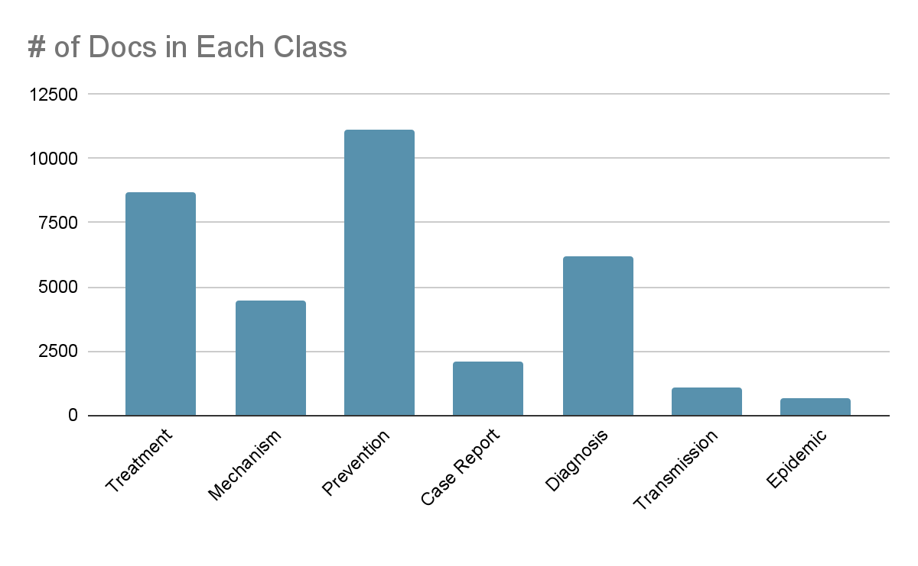
General Status
We used meaningful parts of the dataset such as title, abstract and keyword parts of documents to classify them correctly.
As you can see from the graph almost half of the documents are labels as Prevention and Treatment. These are the dominant classes.
Epidemic Forecasting and Transmission occurrence is too small compared to others so this may cause some problems in prediction.

Slide 3
Preprocessing and Stopword Removal
Words like “I, on, that, at” are very common and it will not have much effect on text classification. So we removed words like these from our dataset.
We preprocessed our data with custom preprocessor.
Preprocessor algorithm works as the following:
lowercase the text
removal of special characters
stemming the words using Porter Stemmer

Slide 4
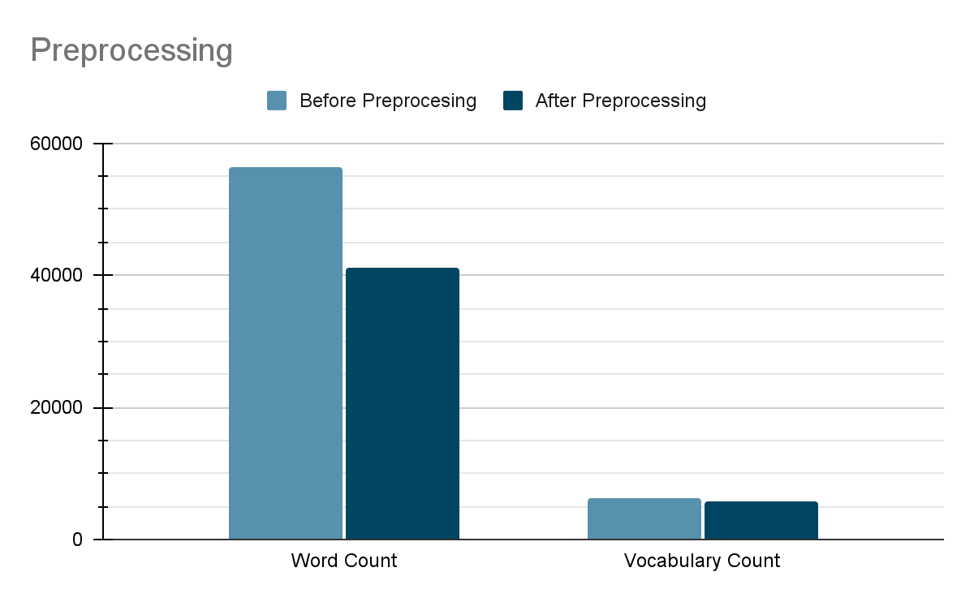
Preprocessing and Stopword Removal
Before preprocess data there are 56502 tokens and 6284 terms in our dataset.
After Preprocessing there are 41190 tokens and 5750 terms in our dataset.

Slide 5
Approaches
We used two different baseline approaches: Multinomial Naive Bayes and K-NN algorithms.
We used SVM to analyze better.
We used both scikit.learn library and our implementations from scratch.
We analyzed the results and compared the outcomes.
We visualized datasets.

Slide 6
Multinomial Naive Bayes
We used scikit-learn tools to create and train our model.
Initially we used naïve Bayes classifier.
We also implemented a classifier from scratch.
The Naive Bayes classifier is a simple classifier that classifies based on probabilities of events.
It is been applied commonly to text classification.
Though it is a simple algorithm, it performs well in many text classification problems.

Slide 7
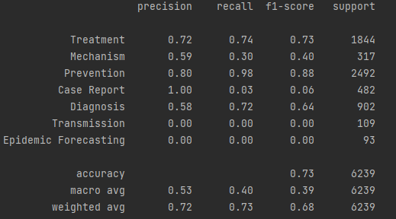
Scikit Learn MNB
We used development dataset for testing.
These results are the success rates of our classification for development dataset.
In development dataset we made same preprocessing and stopword removal as we did in training data.

Slide 8
Scikit Learn MNB
Case Report, Transmission and Epidemic Forecasting classes can not classified correctly.
You can see that their recall rates are very low.
Number of documents in these classes are considerably low. This situation results in misclassification.
Weighted average of recall rate is sufficiently higher because other classes have more documents and they are classified correctly.

Slide 9
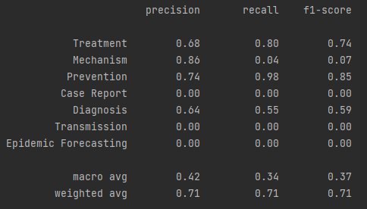
From Scratch MNB
We tried to get better results than before developments but we get similar results.
Results are similar with scikit learn results.

Slide 10
Support Vector Machine
In machine learning, support-vector machines are supervised learning models with associated learning algorithms that analyze data for classification and regression analysis.
After MultinomialNB, we used SVM to increase our success rates.
With the help of the SVM, we tried to classify 'Transmission', ‘Case Report’ and 'Epidemic Forecasting' classes properly.
Advantages of SVM:
Effective in high dimensional spaces.
Memory efficient.

Slide 11
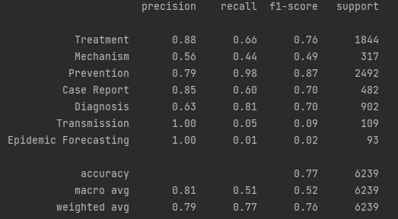
Results After SVM
The recall score for Case Report increased noticeably after SVM.
Transmission and Epidemic Forecasting also increased but it is not in a desired level.
It is clear that the macro and weighted average calculations also increased after improvements in recall and f1-score.
As we can see in two pictures precision and recall are also increased. It shows that SVM classifies more correctly.

Slide 12
Visualization
In the training step, we created a sparse matrix with shape of (34246, 41189).
It was impossible to visualize this kind of matrix.
We used dimension reduction (PCA) to visualize this document vectors. However, it requires giant amount of ram. So we divided our dataset and visualize a part of it (4000 documents).

Slide 13
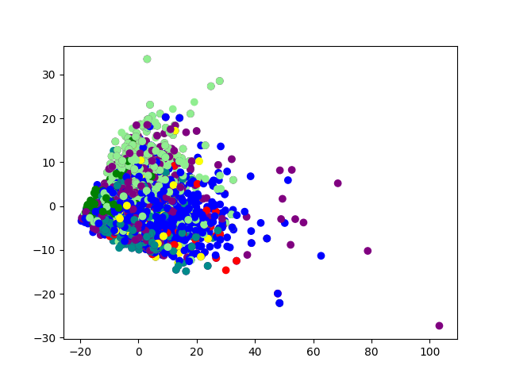
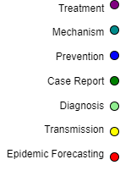
Dataset With Original Labels

Slide 14
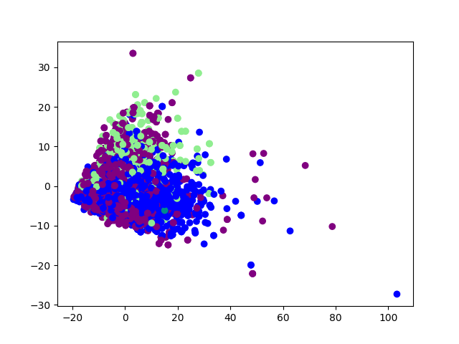

Dataset With MNB

Slide 15
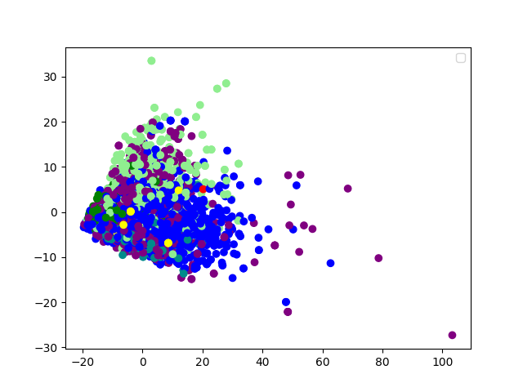
After SVM

Slide 16
KNN Approach
We used both scikit.learn library KNN classifier and implement our KNN algorithm.
We compared multilabel kNN and single-label kNN
We made visualization on single-label kNN
We tried different k’s and different thresholds.

Slide 17
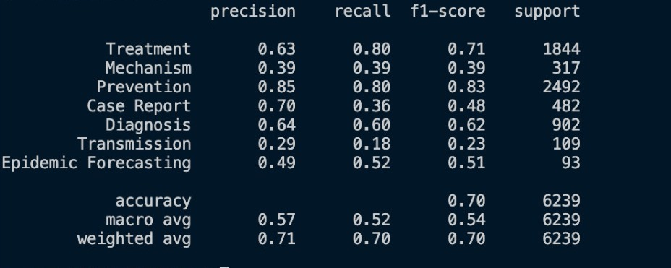
Single Label kNN Algorithm

Slide 18
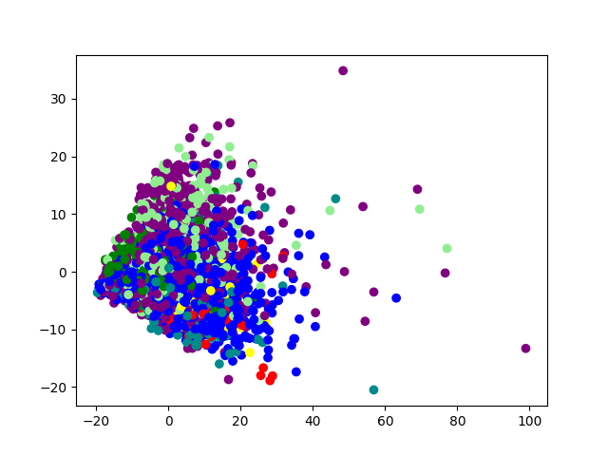
Original labels of Test Dataset

Slide 19
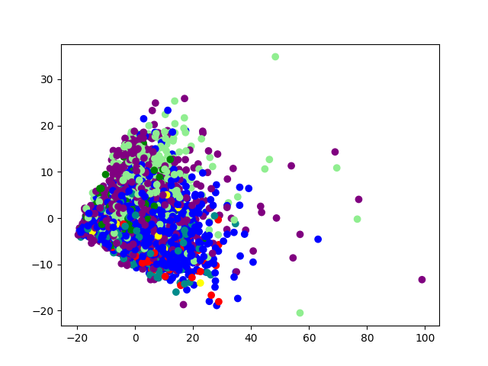
kNN PCA Visualization

Slide 20
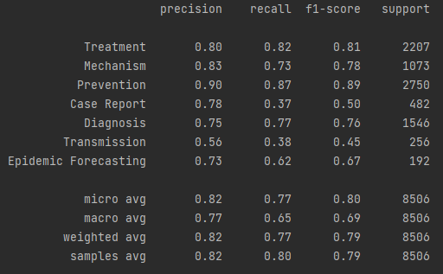
Multilabel kNN Algorithm
The Mechanism, Transmission and Epidemic Forecasting which are low in the single label knn have increased noticeably.
It is clear that the macro and weighted average calculations also increased after multi label knn algorithm.

Slide 21
Our Method
We implemented a KNN based method for the classification.
We used cosine similarities.
For the multilabeling, we tried some different methods and k’s.
We used 1000 documents from training set as a development set. So, we did not make our tuning with test set.
Generally we compared a threshold with “(occurence of class in kNN)/(total document count of this class)”

Slide 22
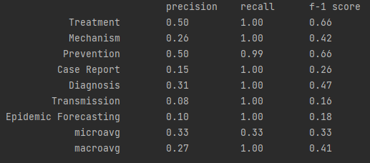
Without Threshold

Slide 23
Basic Threshold
Initially we tried to use a global threshold for all classes.
We tried different global thresholds.
Best working threshold was (3*k/2)/11102.
Prevention is the most frequent class with 11102 occurrences.
With this threshold, we could increase the precision for classes.

Slide 24
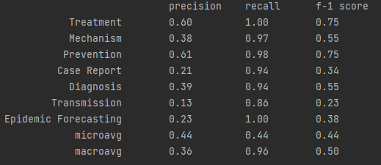
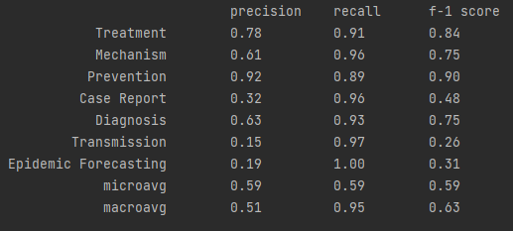
Basic Threshold Method

Slide 25
Best Result
Best working method was using threshold as “(class count)/(all documents count)”
If we are working on transmission, the threshold will be 645/34246
If we are working on prevention, the threshold will be 11102/34246
So, threshold for prevention will be higher. Thus we can restrict the frequent classes and advanced recall for infrequent classes.

Slide 26
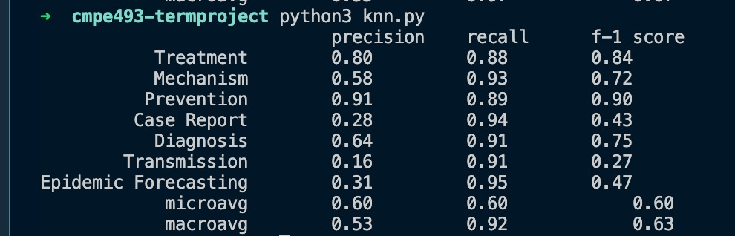
With the Best Threshold

Slide 27
Challenges
'Transmission', ‘Case Report’ and 'Epidemic Forecasting' classes contain very little data compared to others.
This situation resulted in underfitting for these classes.
As you can see from graphs, our trained model can not detect these classes properly.
Documents which originally belong to these classes can be misclassified and labeled with other class names.
We used Support Vector Machine to overcome this problem.

Slide 28
After previous work
We tried to improve ‘Transmission’ and 'Epidemic Forecasting' classes but they are still can not be labeled properly.
We used vectorized features. Then we tried to use non-tokenized features.
We implemented KNN algorithm.
We improved preprocessing in order to detect edge features of underfitting classes compare to previous.
We improved the implementation of naive Bayes method.
We compared the results with previous work.
We compared to single label knn and multilabel knn results.
We get best result in multilabel knn algorithm.

Slide 29
Possible Improvements
‘Transmission’ and 'Epidemic Forecasting' classes are still can not be labeled properly.
We can analyze the words inside these classes. There should be some common words which could not be detected by kNN algorithm. We can implement a better relationship for words and classes.
A better threshold mechanism can be implemented to KNN and MNB.
We can eliminate the words that exceed a certain rate in documents.

Slide 30
References
https://scikit-learn.org/stable/modules/generated/sklearn.feature_extraction.text.CountVectorizer.html#sklearn.feature_extraction.text.CountVectorizer
https://medium.com/analytics-vidhya/naive-bayes-classifier-for-text-classification-556fabaf252b
https://scikit-learn.org/stable/modules/naive_bayes.html#naive-bayes
https://scikit-learn.org/stable/tutorial/text_analytics/working_with_text_data.html
https://kavita-ganesan.com/how-to-use-countvectorizer/#.YcwF_vBByUl
https://scikit-learn.org/stable/modules/svm.html#svm
https://towardsdatascience.com/support-vector-machine-introduction-to-machine-learning-algorithms-934a444fca47
https://scikit-learn.org/stable/modules/generated/sklearn.neighbors.KNeighborsClassifier.html

